Slide 1
Chapter 4 Recurrences
Hsu, Lih-Hsing
(Updated by B.M.T. Lin)

Slide 2
Divide and Conquer
Divide: Divide the original problem into several sub-problems of the same nature
Conquer: Solve each of the sub-problems independently
Combine: Merge the solutions to each sub-problem into a single solution to the original problem

Slide 3
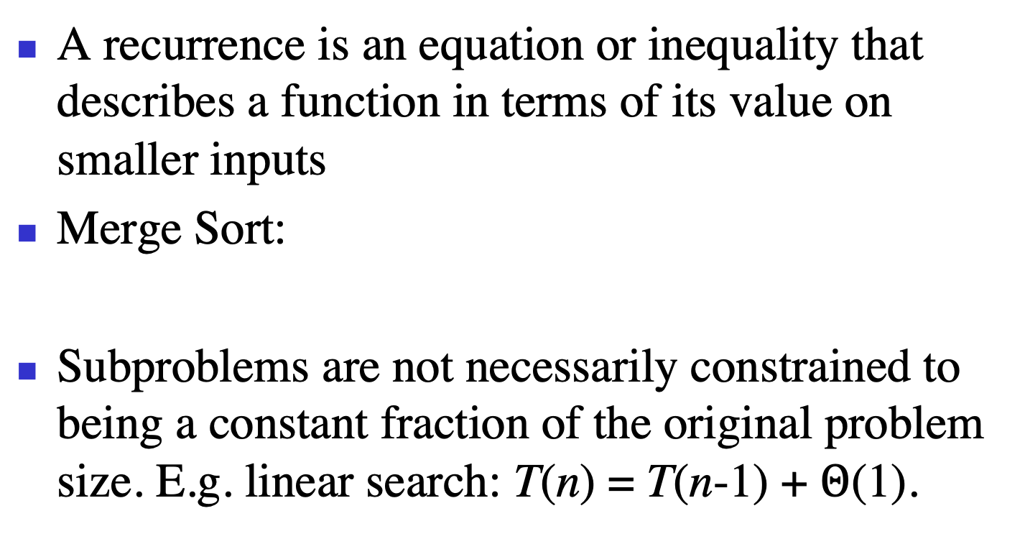
Recurrences
A recurrence is an equation or inequality that describes a function in terms of its value on smaller inputs
Merge Sort:
Subproblems are not necessarily constrained to being a constant fraction of the original problem size. E.g. linear search: T(n) = T(n-1) + $Θ$(1).

Slide 4
Three Methods for Solving Recurrences
Substitution method: guess a bound and then use mathematical induction to prove the guess correct
Recursion-tree method: convert the recurrence into a tree whose nodes represent the costs incurred at various levels of the recursion
Master method:

Slide 5
Maximum Subarray Problem
Given a sequence of numbers, find two numbers such that change from the first one to the last one is maximum

Slide 6
Approaches
Naïve method (brute force method): Try every possible pair of buy and sell dates in which the buy date precedes the sell date. We need to examine C(n,2) = n(n-1)/2 pairs of numbers

Slide 7
Maximum Subarray Problem
Transformation: Consider the daily change in price, where the change on day i is the difference between the prices after day i-1 and after day i
Given a sequence of changes between two consecutive days, find a subsequence whose sum is maximum
Required running time?

Slide 8
Divide-and-Conquer Approach
Find (1) two maximum sums of two subproblems, and (2) the maximum sum across two subarrays

Slide 9
Divide-and-Conquer
Case 1: Entirely in the subarray A[low, mid]
Case 2: Entirely in the subarray A[mid+1, high]
Case 3: Crossing the middle point:
low <= i <= middle < j <= high

Slide 10
FIND-MAX-CROSSING-SUBARRAY(A; low; mid; high)
1 left-sum = - ∞
2 sum = 0
3 for i = mid downto low
4 sum = sum + A[i]
5 if sum > left-sum
6 left-sum = sum
7 max-left = i
8 right-sum = - ∞
9 sum = 0
10 for j = mid = 1 to high
11 sum = sum + A[j]
12 if sum > right-sum
13 right-sum = sum
14 max-right = j
15 return (max-left; max-right; left-sum+right-sum)
Required running time
= (mid-low+1)+(high-mid)
= high-low+1
= (Why?)

Slide 11
FIND-MAXIMUM-SUBARRAY(A; low; high)
1 if high == low
2 return (low; high; A[low])
3 else mid =
4 (left-low; left-high; left-sum)=
FIND-MAXIMUM-SUBARRAY(A; low; mid)
5 (right-low; right-high; right-sum)=
FIND-MAXIMUM-SUBARRAY(A; mid+1; high)
6 (cross-low; cross-high; cross-sum)=
FIND-MAX-CROSSING-SUBARRAY(A; low;
mid; high)
7 if (left-sum ≥ right-sum) and (left-sum ≥ cross-sum)
8 return (left-low; left-high; left-sum)
9 elseif (right-sum ≥ left-sum) and (right-sum ≥ cross-sum)
10 return (right-low; right-high; right-sum)
11 else return (cross-low; cross-high; cross-sum)
initial call FIND-MAXIMUM-SUBARRAY(A; 1; A:length)

Slide 12
Analyzing the Algorithm

Slide 13
Strassen’s algorithm for matrix multiplication
If A = (a_{ij}) and B = (b_{ij}) are square nxn matrices, then in the product C = A•B, we define the entry c_{ij} by
Any matrix multiplication algorithm must take Ω(n³) time?

Slide 14
Divide-and-conquer algorithm for matrix multiplication
Partition each of A, B, and C into four (n/2)x(n/2) matrices

Slide 15
V. Strassen,
Gaussian elimination is not optimal,
Numerische Mathematik, 13(1969), 354-356.

Slide 16
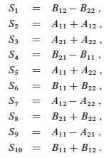
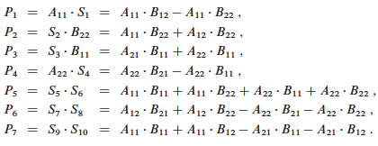
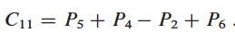
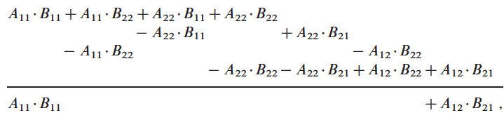
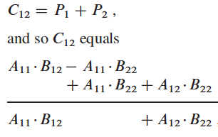
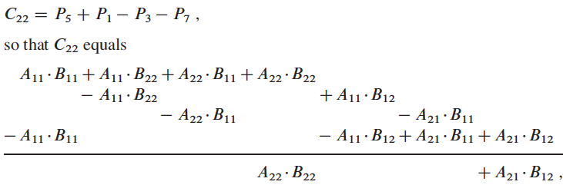
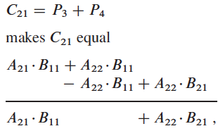

Slide 17
Strassen’s algorithm for matrix multiplication

Slide 18
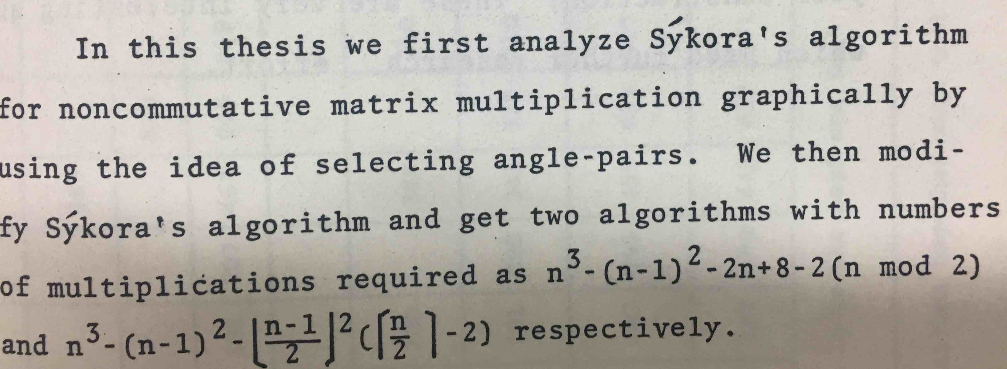
Master Thesis of S.S. Tseng
(Department of Computer Engineering, 1981, NCTU)

Slide 19
Recurrences --
T(n)=a(T(n/b)) + f(n)
Substitution method
Recursion-tree method
Master method

Slide 20
Technicalities
We neglect certain technical details when we state and solve recurrences
A good example of a detail that is often glossed over is the assumption of integer arguments to functions
Boundary conditions is ignored
Omit floors, ceilings.

Slide 21
4.1 The substitution method (mathematical induction)
The substitution method for solving recurrence entails two steps:
1. Guess the form of the solution.
2. Use mathematical induction to find the constants and show that the solution works.

Slide 22
Example
(We may omit the initial condition later.)
Guess
Assume

Slide 23
Initial condition
To overcome this difficulty concerning the boundary condition of n₀ = 1, we move to from 1 to a larger n₀

Slide 24
Making a good guess
Unfortunately, there is no general way to guess the correct solutions to recurrences
Given
We guess
Making guess provides loose upper bound and lower bound. Then improve the gap.

Slide 25
Subtleties
Guess
Assume
However, assume

Slide 26
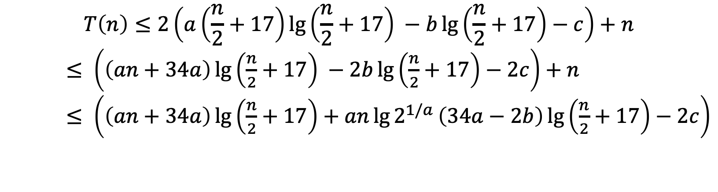
$$T\left(n\right)≤2\left(a\left(\frac{n}{2}+17\right)\lg\left(\frac{n}{2}+17\right) −b\lg\left(\frac{n}{2}+17\right)−c\right)+n$$
$≤ \left(\left(an+34a\right)\lg\left(\frac{n}{2}+17\right) −2b\lg\left(\frac{n}{2}+17\right)−2c\right)+n$
$≤ \left(\left(an+34a\right)\lg\left(\frac{n}{2}+17\right)+an\lg{2^{1/a}}\left(34a−2b\right)\lg\left(\frac{n}{2}+17\right)−2c\right)$

Slide 28
Avoiding pitfalls
Assume
Hence,
(WRONG!) You cannot find such a c.
T(n)=O(n)

Slide 29
Changing variables

Slide 30
4.2 Recursion-tree method

Slide 31
The subproblem size for a node at depth i is n/4^{i}.
The total cost over all nodes at depth i = (3/16)^{i}cn²

Slide 32
The cost of the entire tree

Slide 34
Substitution Method
We want to show that T(n) ≤ dn² for some constant d > 0. using the same constant c > 0 as before, we have
where the last step holds as long as d ≥(16/13)c.

Slide 36
Substitution Method
As long as d ≥ c/lg3 – (2/3)).

Slide 37
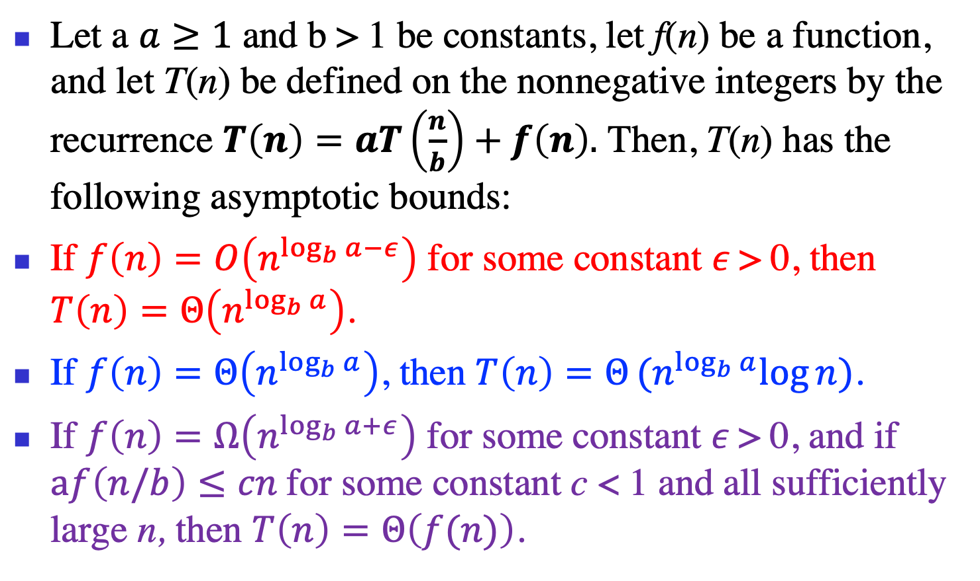
4.3 The Master Method
Let a $a≥1$ and b > 1 be constants, let f(n) be a function, and let T(n) be defined on the nonnegative integers by the recurrence $T\left(n\right)=aT\left(\frac{n}{b}\right)+f\left(n\right).$ Then, T(n) has the following asymptotic bounds:
If $f\left(n\right)=O\left(n^{\log_{b}{a−ε}}\right)$ for some constant $ε$> 0, then $T\left(n\right)=Θ\left(n^{\log_{b}{a}}\right)$.
If $f\left(n\right)=Θ\left(n^{\log_{b}{a}}\right)$, then $T\left(n\right)=Θ(n^{\log_{b}{a}}log{n)}$.
If $f\left(n\right)=Ω\left(n^{\log_{b}{a+ε}}\right)$ for some constant $ε$> 0, and if $af\left(n/b\right)≤cn$for some constant c < 1 and all sufficiently large n, then $T\left(n\right)=Θ\left(f(n)\right)$.

Slide 38
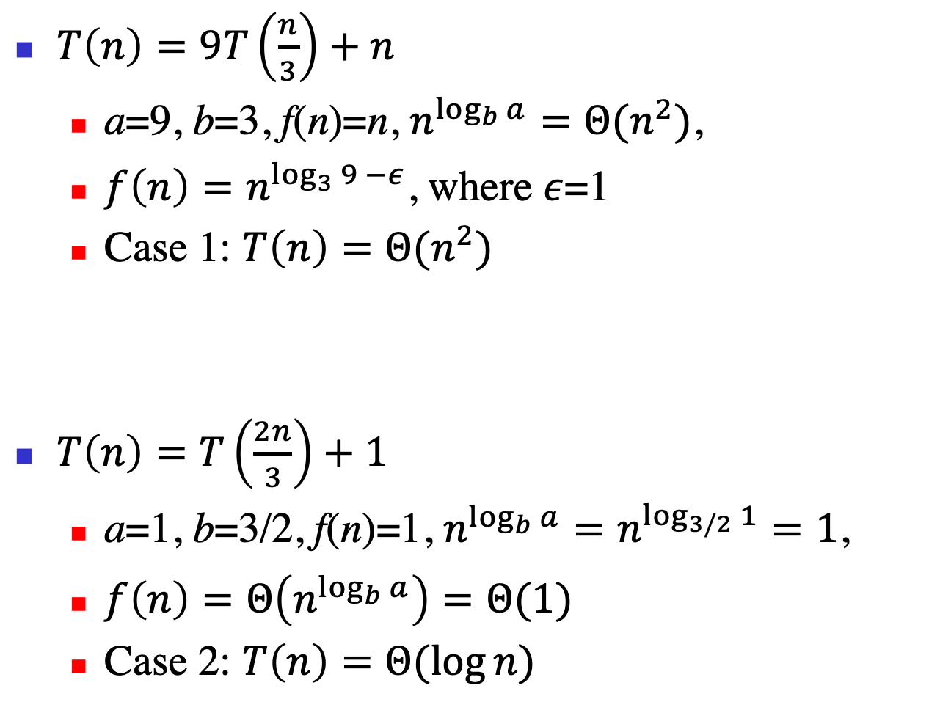
$T\left(n\right)=9T\left(\frac{n}{3}\right)+n$
a=9, b=3, f(n)=n, $n^{\log_{b}{a}}=Θ(n^{2})$,
${f\left(n\right)=n}^{\log_{3}{9 −ε}}$, where $ε$=1
Case 1: $T\left(n\right)=Θ(n^{2})$
$T\left(n\right)=T\left(\frac{2n}{3}\right)+1$
a=1, b=3/2, f(n)=1, $n^{\log_{b}{a}}=n^{\log_{3/2}{1}}=1$,
${f\left(n\right)=Θ\left(n^{\log_{b}{a}}\right)=Θ(1)}^{}$
Case 2: $T\left(n\right)=Θ(\log{n})$

Slide 39
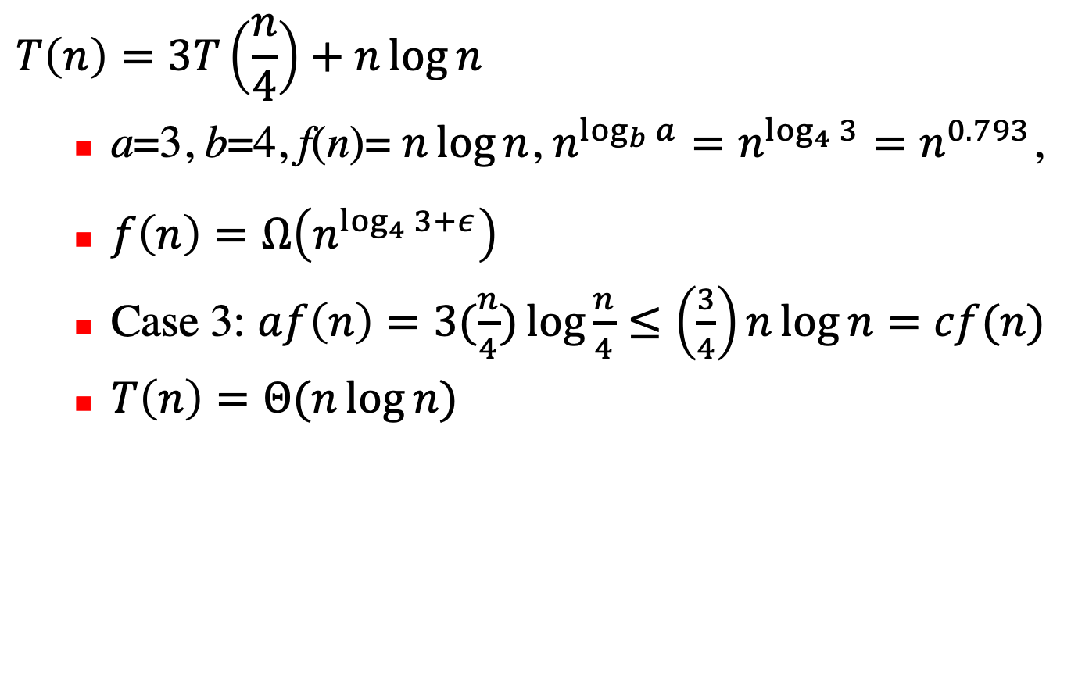
$$T\left(n\right)=3T\left(\frac{n}{4}\right)+n\log{n}$$
a=3, b=4, f(n)= $n\log{n}$, $n^{\log_{b}{a}}=n^{\log_{4}{3}}=n^{0.793}$,
${f\left(n\right)=Ω\left(n^{\log_{4}{3}+ε}\right)}^{}$
Case 3: $af\left(n\right)=3(\frac{n}{4})\log{\frac{n}{4}}≤\left(\frac{3}{4}\right)n\log{n=cf(n)}$
$T\left(n\right)=Θ(n\log{n})$

Slide 40
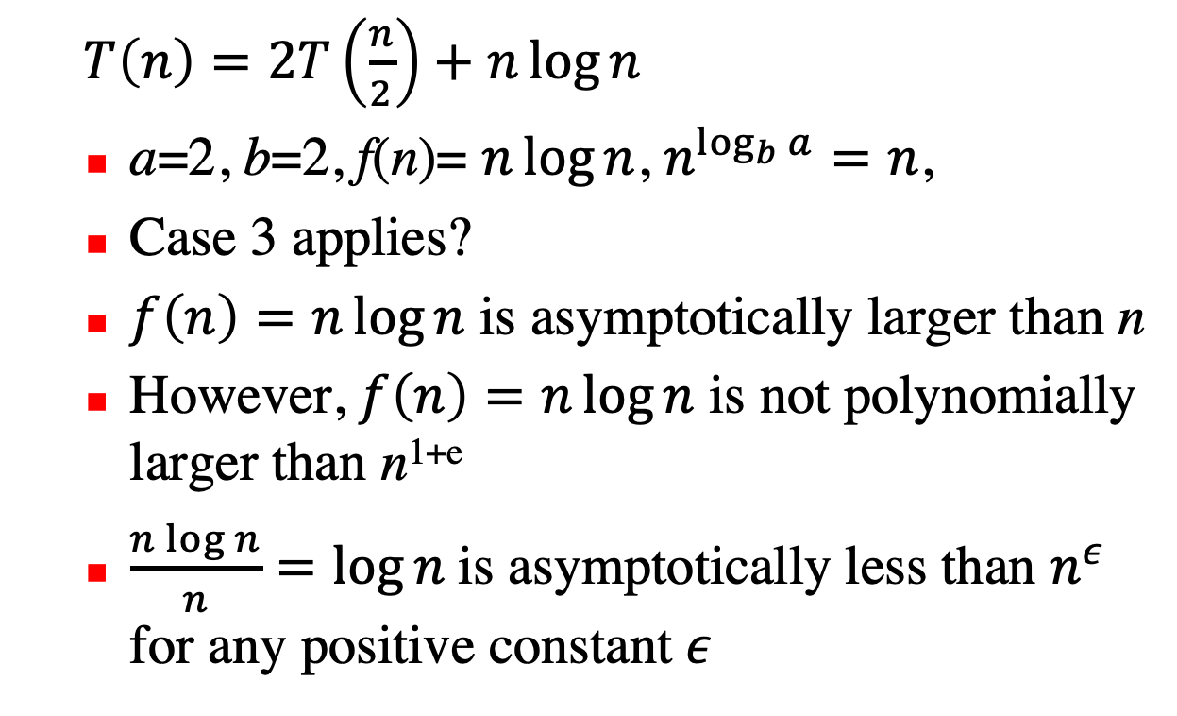
$T\left(n\right)=2T\left(\frac{n}{2}\right)+n\log{n}$
a=2, b=2, f(n)= $n\log{n}$, $n^{\log_{b}{a}}=n$,
Case 3 applies?
$f\left(n\right)=n\log{n}$ is asymptotically larger than n
However, $f\left(n\right)=n\log{n}$ is not polynomially larger than n^{1+e}
$\frac{n\log{n}}{n}=\log{n}$is asymptotically less than $n^{ε}$ for any positive constant $ε$

